Slide 1
Determining First Impression via User Description
Markiyan Varhola

Slide 2
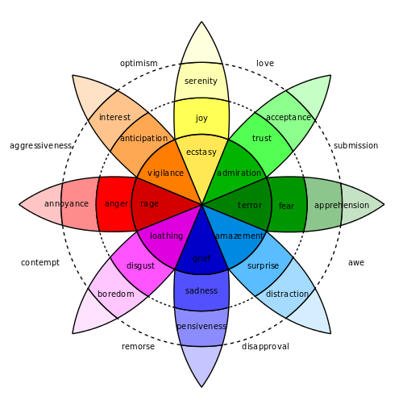
Concept
Derive the general first impression of an image by analyzing the emotion of the person describing it.

Slide 3
Methods
Show the user an image
Ask them to describe it shortly
Analyze their response
Calculate the prevalence of different emotions

Slide 4
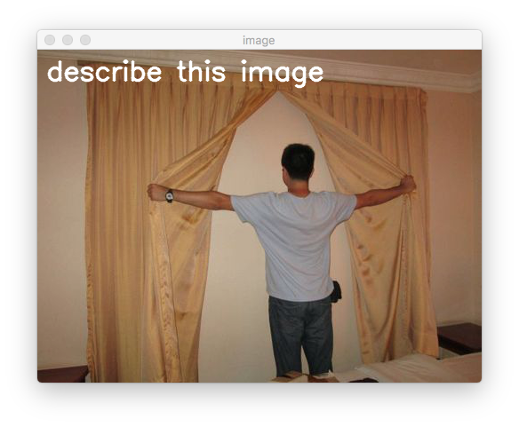

Slide 5
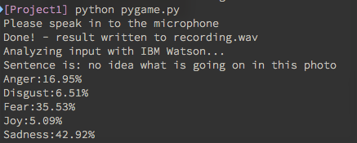

Slide 6
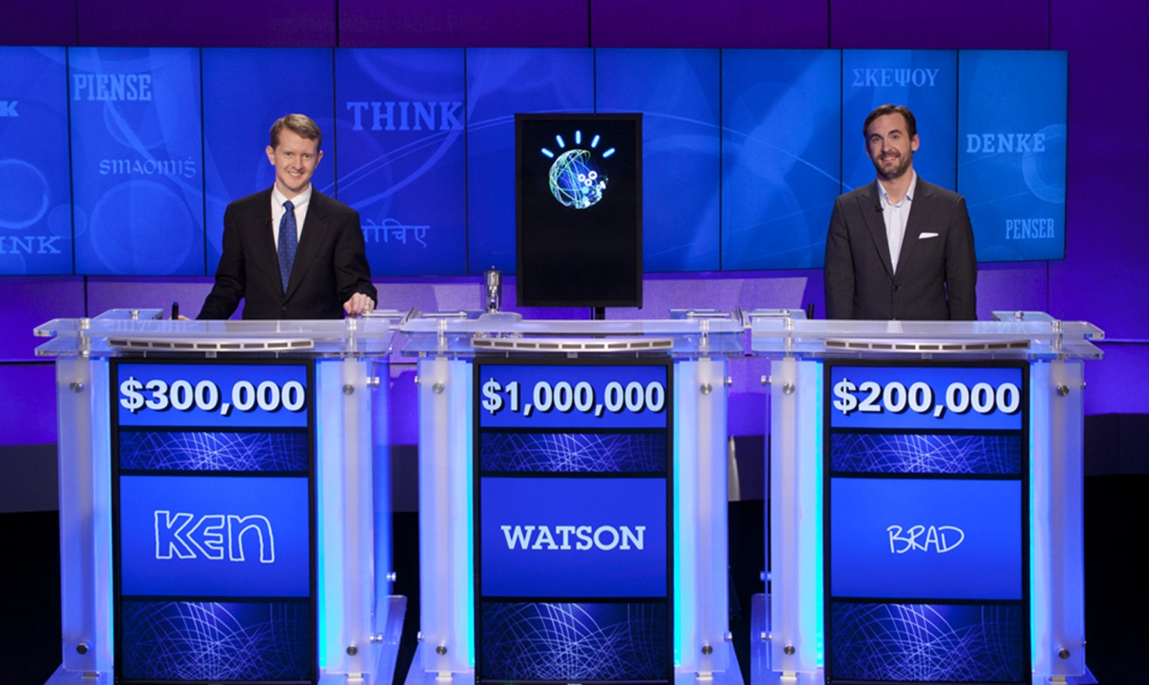
Behind the Scenes
IBM Watson
Speech-to-text API
Allows for accurate translation of speech to text for analysis
Emotion Analysis API
Analyzes the prevalence of five different emotions in the text

Slide 7
User Study
Show user multiple images
Record the response
Analyze the response for emotion
Record the analysis to a file
Combine analysis with image for a general first impression

Slide 8
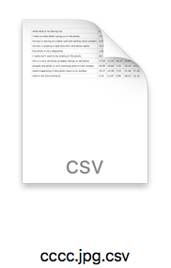

Slide 9
